Slide 1
Exit
HOTEL BOOKING SYSTEM
Database
Website template
Dashboard template
For User
For Admin
General

Slide 2
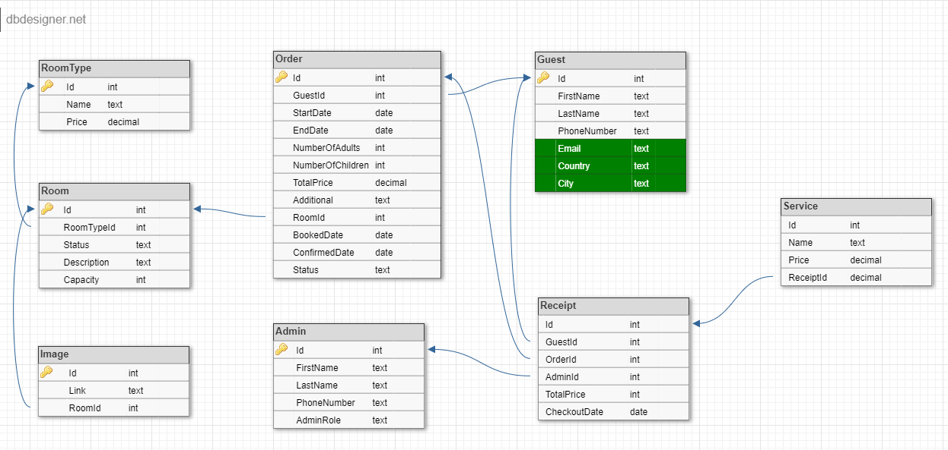
Go home
Database Schema

Slide 3
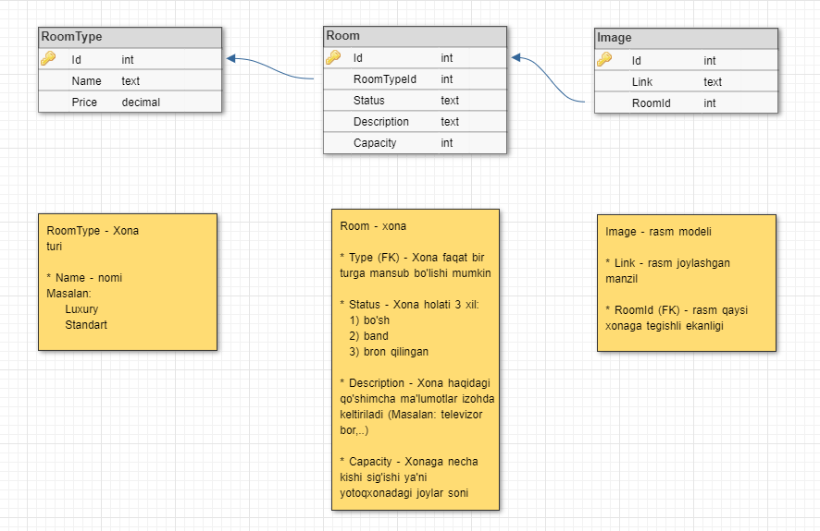
Go home
Izohlar 1-qism

Slide 4
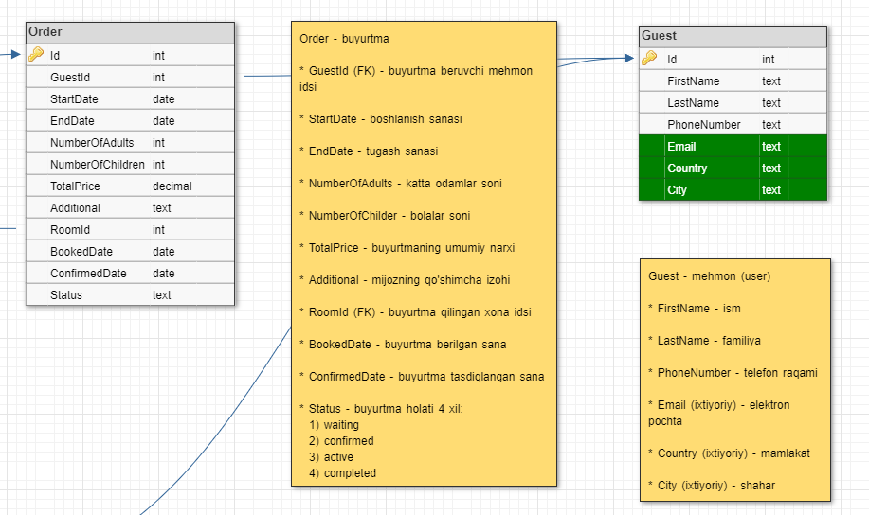
Go home
Izohlar 2-qism

Slide 5
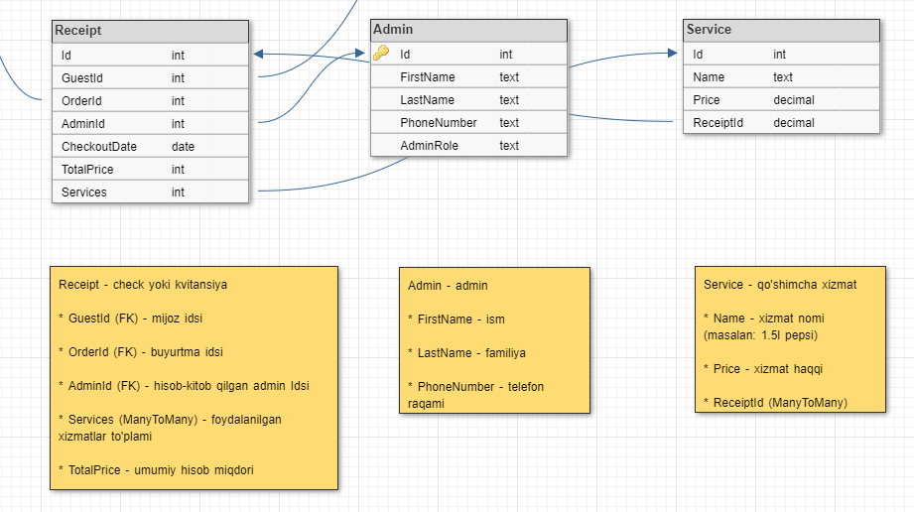
Go home
Izohlar 3-qism

Slide 6
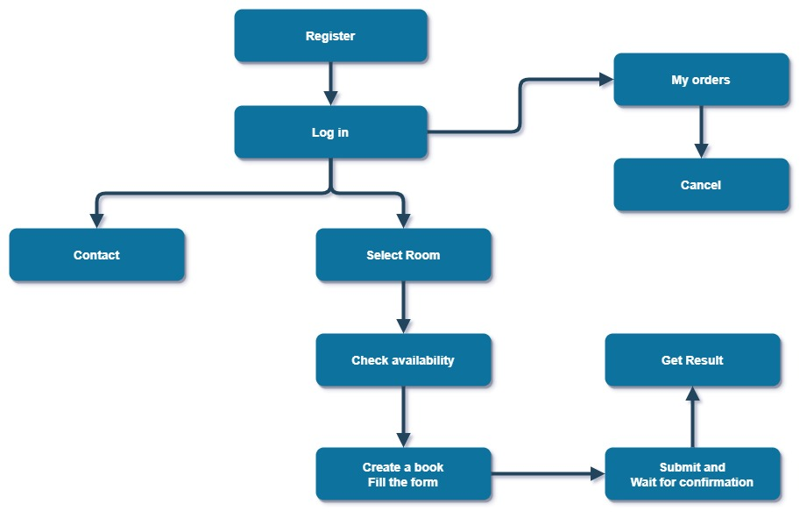
Go home
User imkoniyatlari

Slide 7
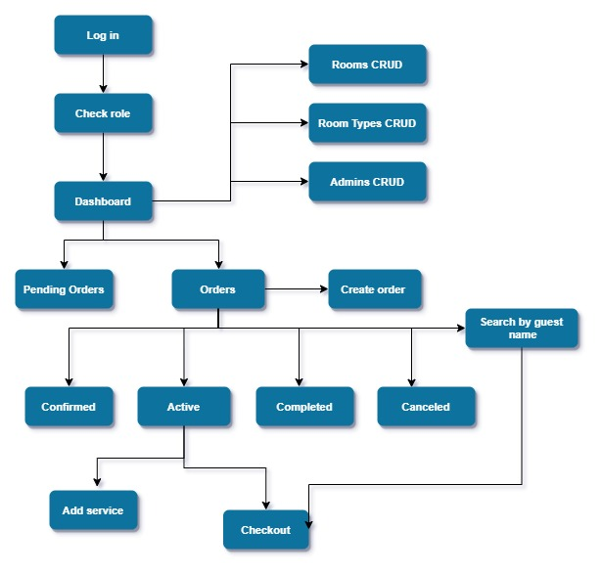
Go home
Admin imkoniyatlari

Slide 8
Go home
Website – 5 ta tilda
2. Admin panel– kamida 2 ta tilda: o’zbek va rus (+english)
3. API

